Slide 1
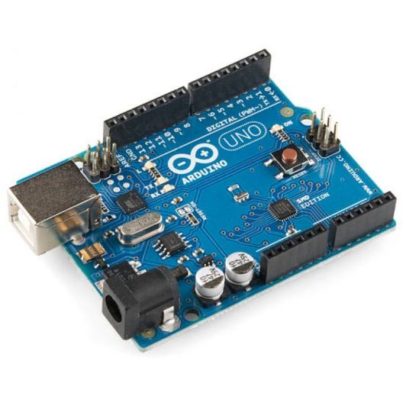
5 axes support
Runs on a plain Arduino Uno

